Slide 1
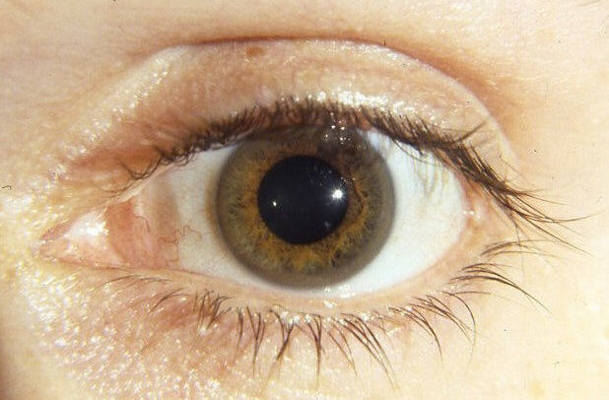
Personal Thoughts On Wilson’s Disease
March 7, 2016
Rob Stall MD
UB SMBS Class of 1983
drstall@stallseniormedical.com

Slide 2
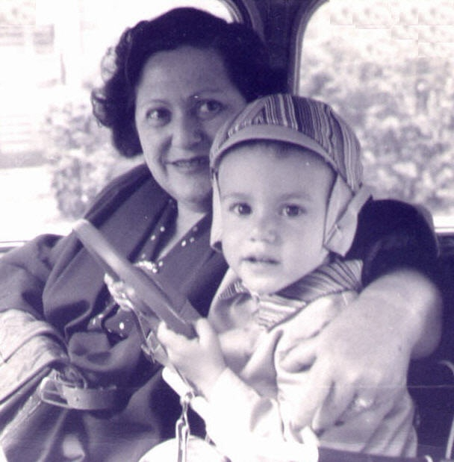
1959
Family History

Slide 3
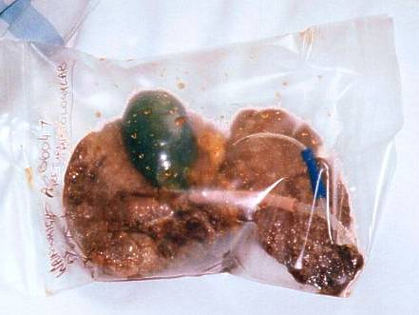
From http://www.livers.org.nz/Recipients/Our_Stories/Bethli/spare%20pics/OffalBag.jpg “The diseased liver that was removed, August 2000…”

Slide 4
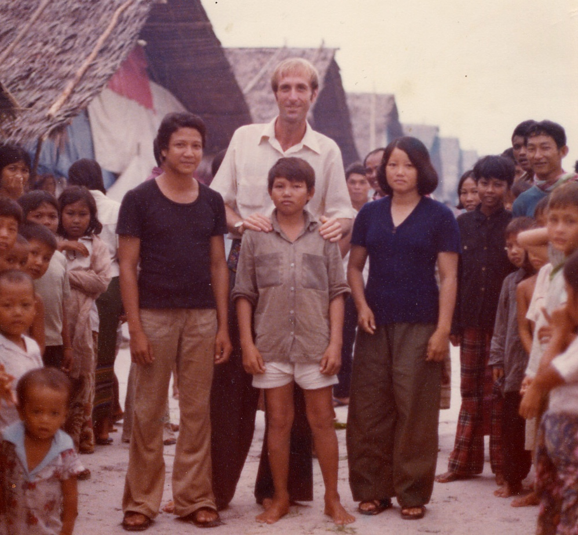
1983
Physical Exam

Slide 5
~1985
“Abnormal pigment… [Descemet’s membrane]… come back in six months…”

Slide 6
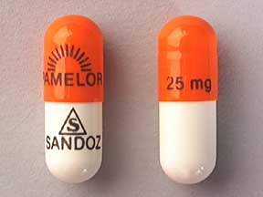
1988
Medication Side Effects?

Slide 7
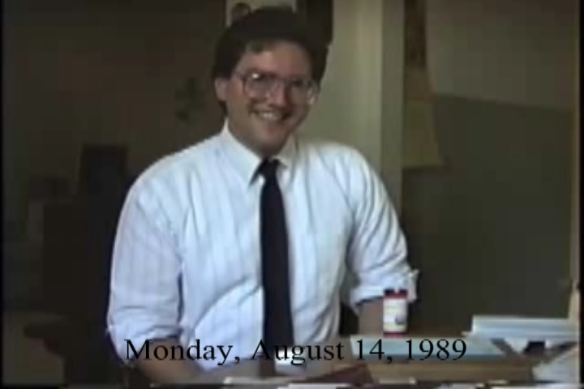

Slide 9
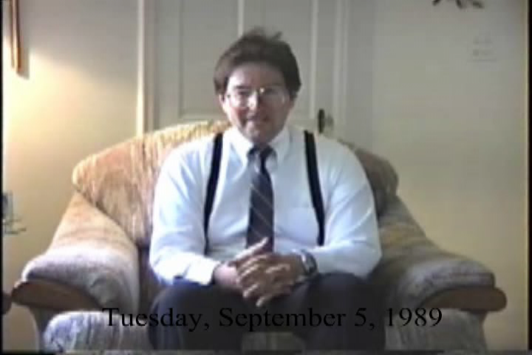

Slide 10
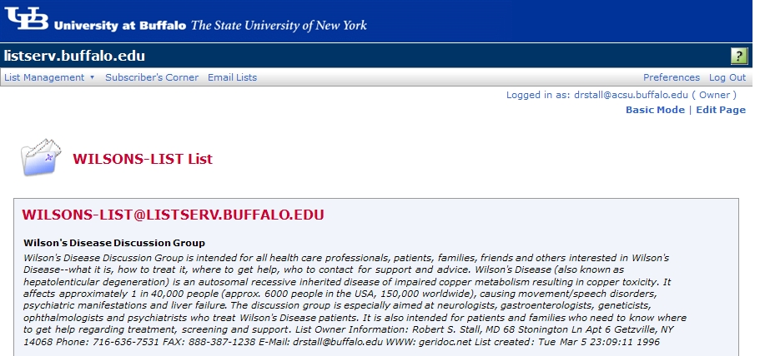
Wilson’s Disease listserv established March 5, 1996

Slide 11
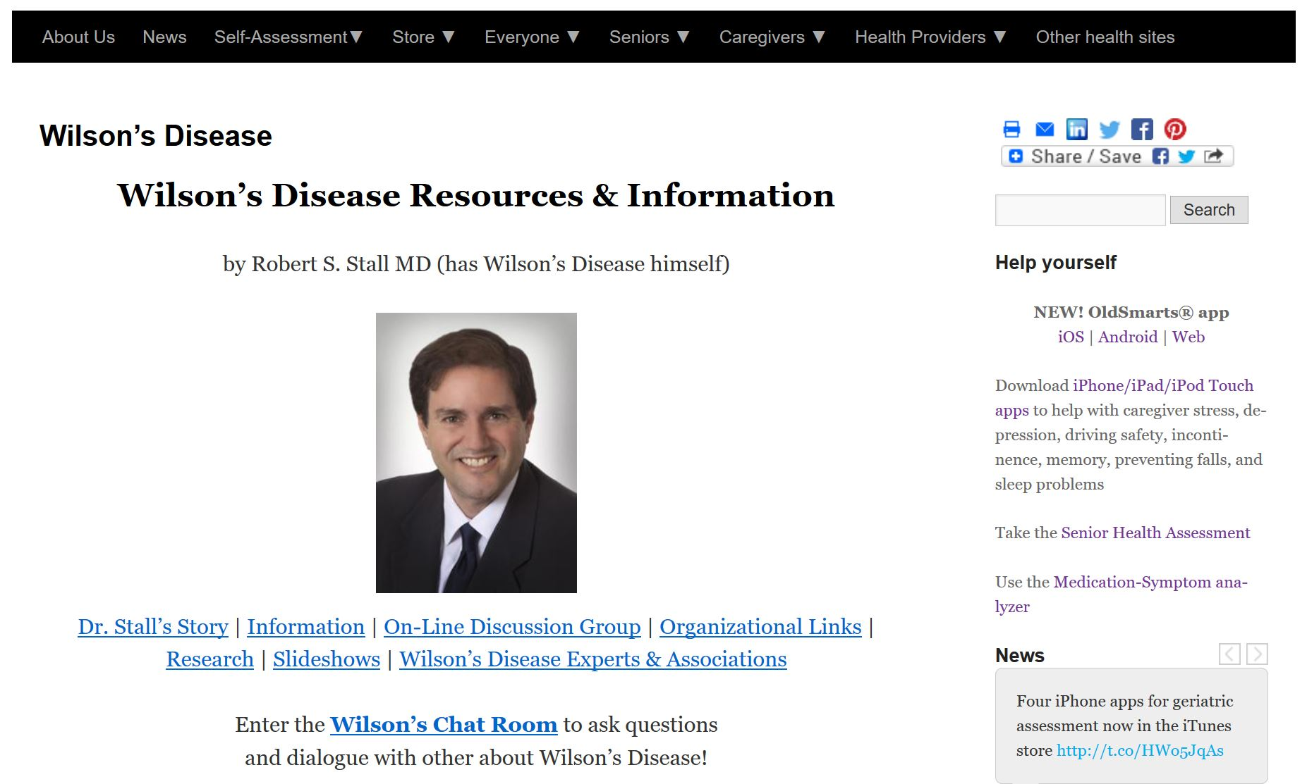
Wilson’s Disease web page established March 30, 1996
http://stallseniormedical.com/dr-stalls-other-web-pages/wilsons-disease/

Slide 12
Book

Slide 13
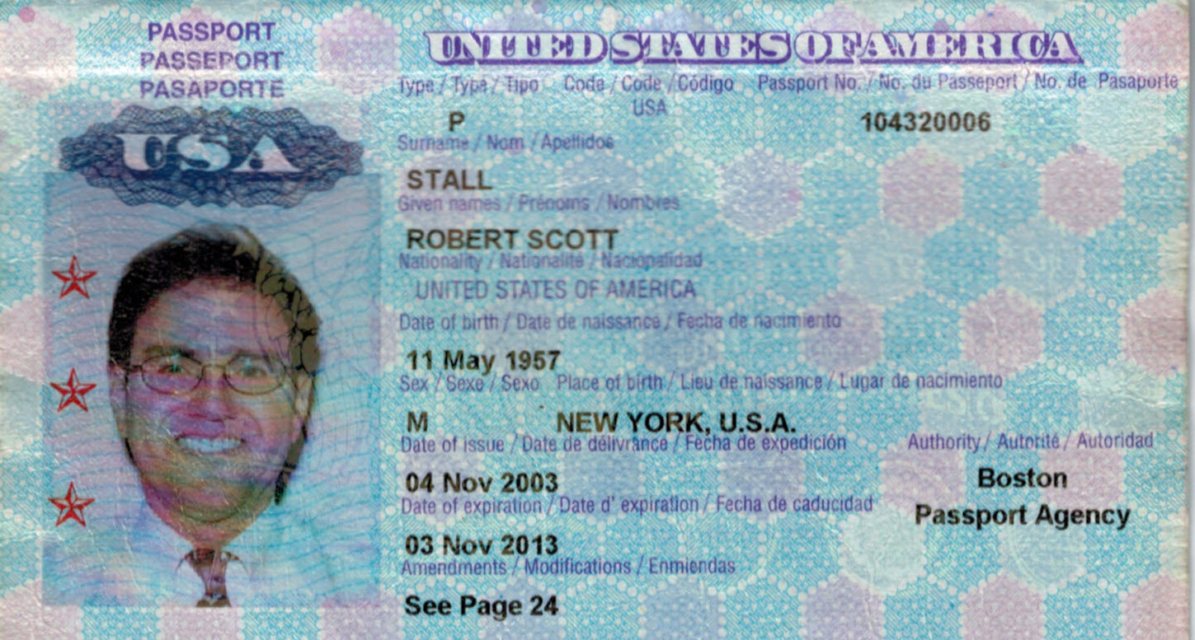
Well

Slide 14
Well

Slide 15
Well

Slide 16
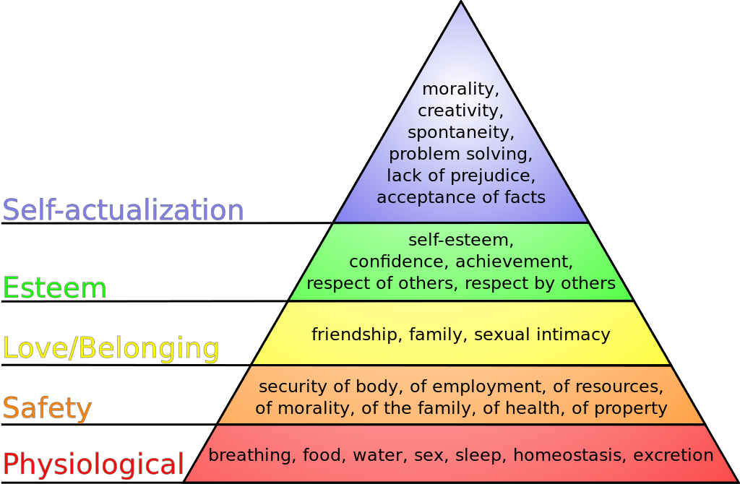
Well
Maslow’s hierarchy of needs

Slide 17
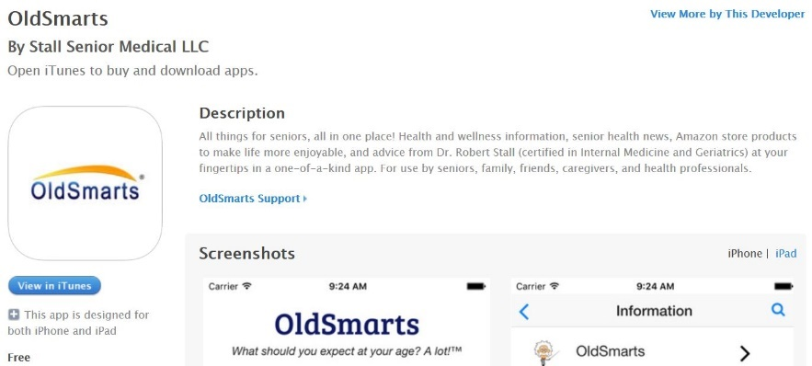
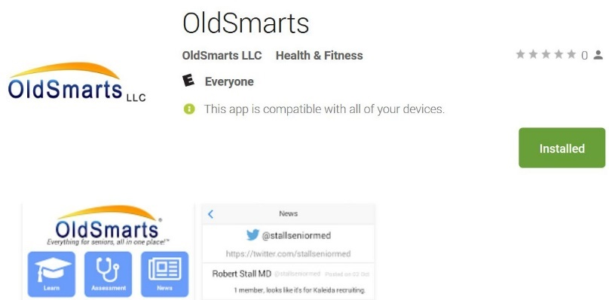
Endowed
Practice
Services include: Annual wellness visits Geriatric consultation
Experimentation

